Slide 1

HOUSING: PRICE PREDICTION
Surprise Housing
By- Anurag Kumar

Slide 2
Background
A US-based housing company named Surprise Housing has decided to enter the Australian market. The company is looking at prospective properties to buy houses to enter the market
The company uses data analytics to purchase houses at a price below their actual values and flip them at a higher price.

Slide 3
Problem Statement
Build a model using Machine Learning in order to predict the actual value of the prospective properties.
Decide whether to invest in them or not.
Which variables are important to predict the price of variable?
]How do these variables describe the price of the house?

Slide 4
Steps Involved
Nan value treatment.
EDA for analysis of features.
Data Visualization.
Correlation Matrix.
Outlier Removal
Log Transformation
Label Encoder
Min Max Scaler
Regression Training

Slide 5
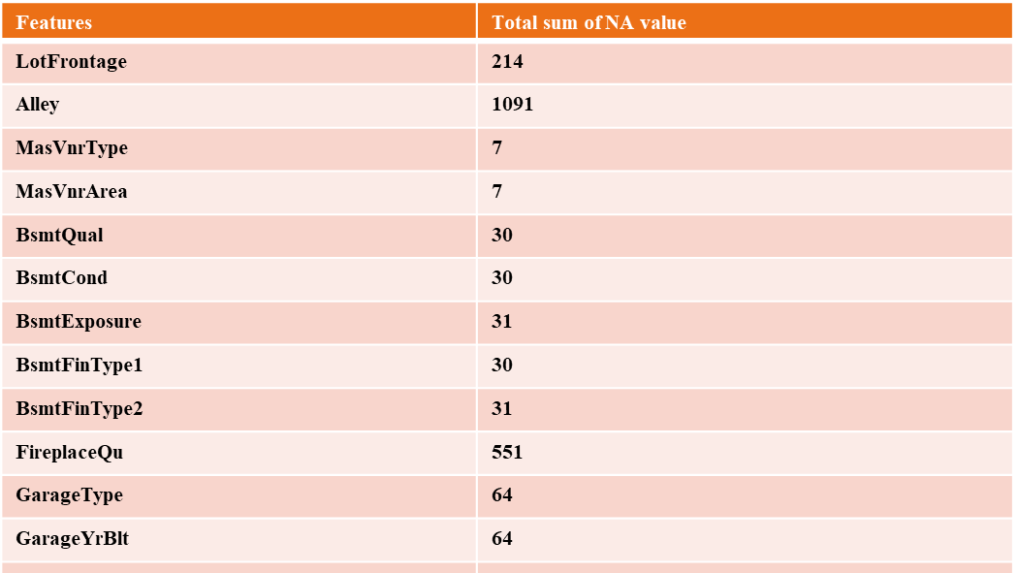

Slide 6
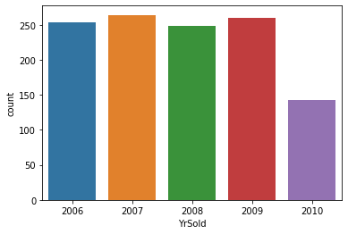
Data Visualization- year sold vs sales count
Year 2010 has least number of sales compared to previous year.

Slide 7
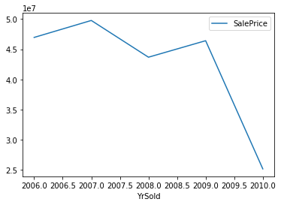
'YrSold’ vs 'SalePrice'

Slide 8
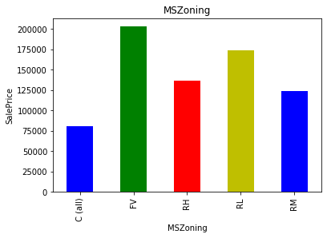
MS Zoning: general zoning classification
  A Agriculture
C Commercial
FV Floating Village Residential
I Industrial
RH Residential High Density
RL Residential Low Density
RP Residential Low-Density Park
RM Residential Medium Density

Slide 9
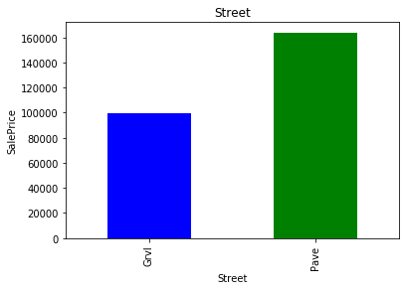
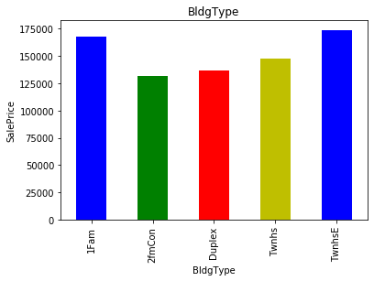
Features vs Median Sales Price
Street
Type Of Dwelling
1Fam -Single-family Detached, 2FmCon-Two-family Conversion,

Slide 10
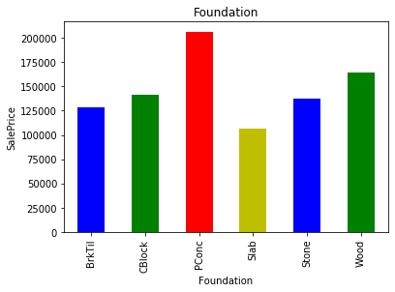
Foundation: Type of foundation
BrkTil Brick & Tile
CBlock Cinder Block
PConc Poured Contrete
Slab Slab
Stone Stone
Wood Wood

Slide 11
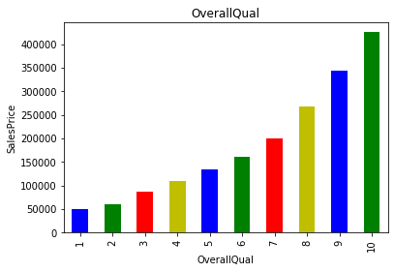
OverallQual:
Overall material and finish of the house

Slide 12
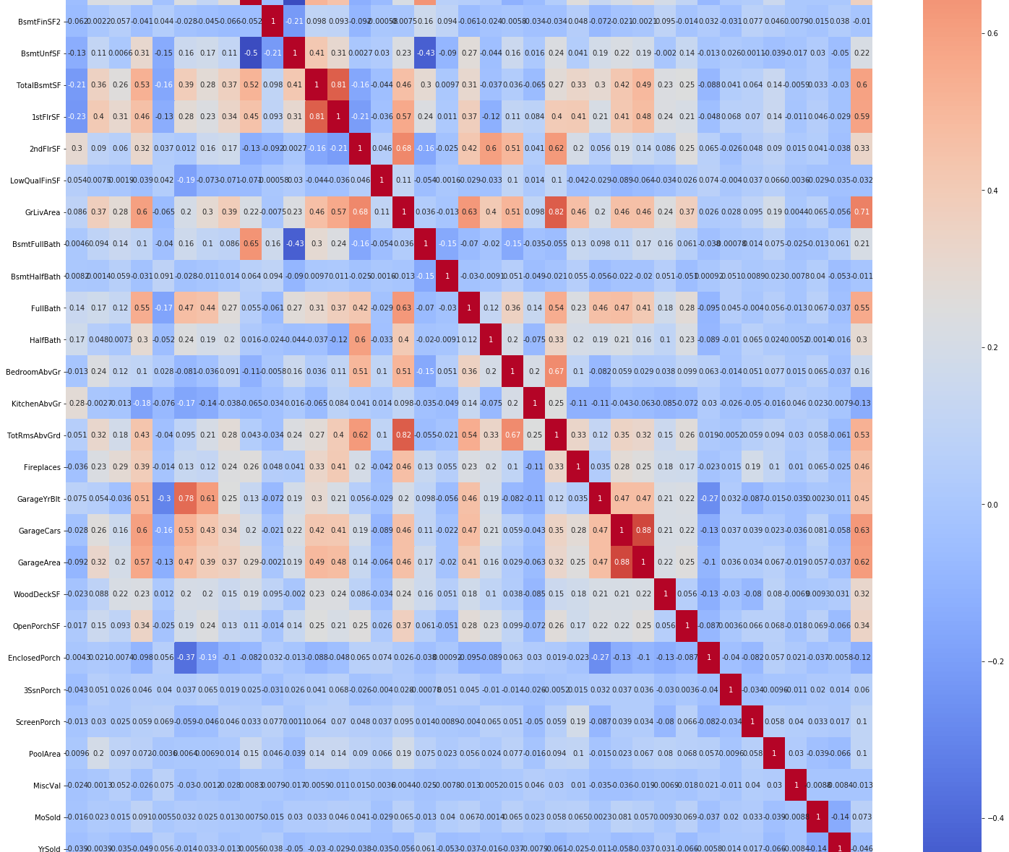
Correlation Matrix
Overall Material Quality is strongly Positive correlated whereas MoSold: Month Sold has very low correlation with Sales Price.

Slide 13
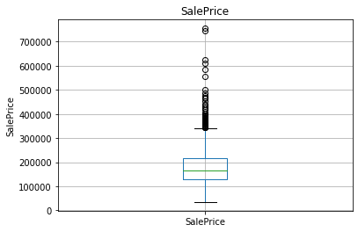
Outlier Treatment
Using Quantile and Max and Min Limit

Slide 14
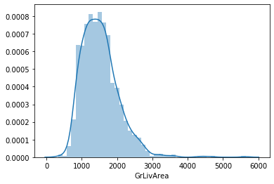
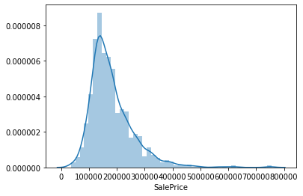
Log Transformation for Normal Curve
for feature in num_features:
df3[feature]= np.log1p(df3[feature])

Slide 15
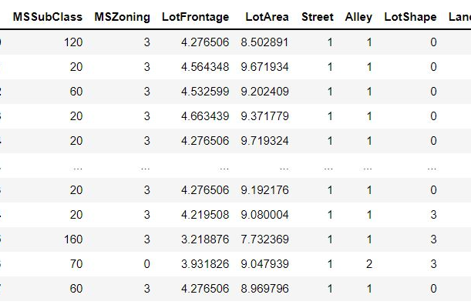
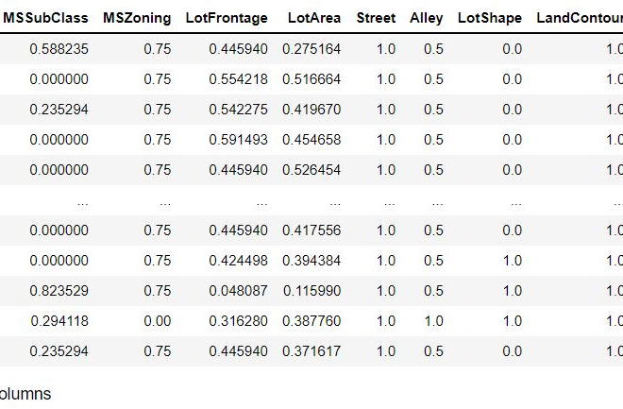
Label Encoding and Min Max Scaler
First figure shows Label Encoding of categorical variables such as MsZoning, Street, Alley etc.
While Second figure depicts Min-Max Scaler, which changes all variables in same range.

Slide 16
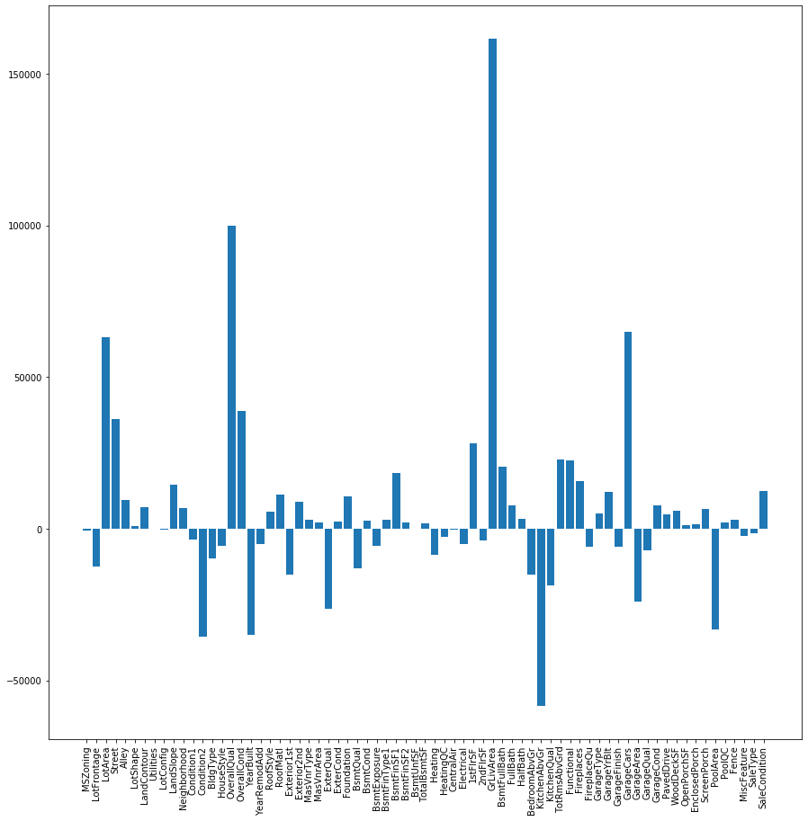
Lasso Regression Model
Lasso selects the only some features while reduces the coefficients of others to zero.

Slide 17
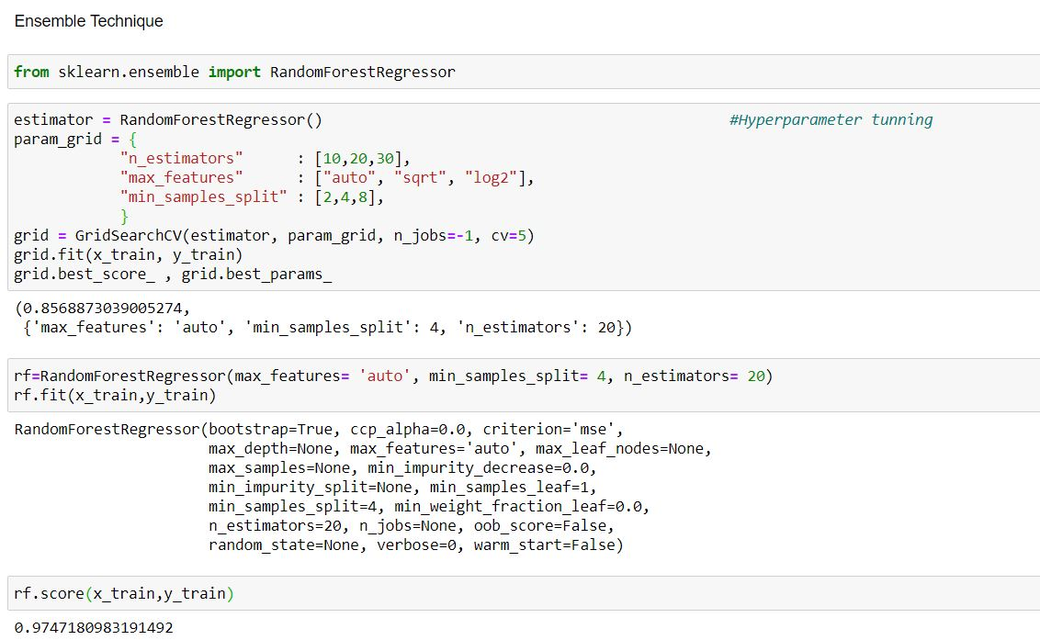
Ensemble Technique
Random Forest Regressor
When training, each tree in random forest learns from a random sample of housing data points. It is also known as bootstrapping.

Slide 18
Conclusion
After Hyper Tuning using GridSearchCV in Lasso, it comes to know alpha=0.1 is best Parameter.
After Hyper Tuning using GridSearchCV in Random Forest, it comes to know max_features= 'auto', min_samples_split= 4, n_estimators= 20, are best parameters.
Accuracy Score of Lasso model is 85%.
Whereas Random Forest Regressor model has score about 97.4%.
Some important features which decide price either in positive or negative way are-
LotArea: Lot size in square feet
BuildingType: Type of dwelling
House Style: Style of dwelling)
OverallQual: Rates the overall material and finish of the house
GrLivArea: Above grade (ground) living area square feet
Kitchen: Kitchens above grade
GarageCars: Size of garage in car capacity

